Slide 1
Niburu
A New mix of Social Media and Musicians.
Notes:
jin

Slide 2
Introduction
What is a Niburu?........
Notes:
jin

Slide 3
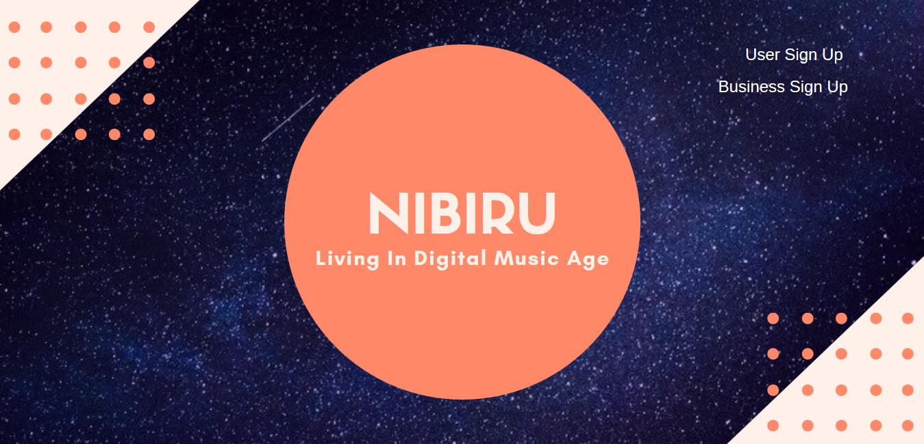
UI -- Main Page
Notes:
jin

Slide 4
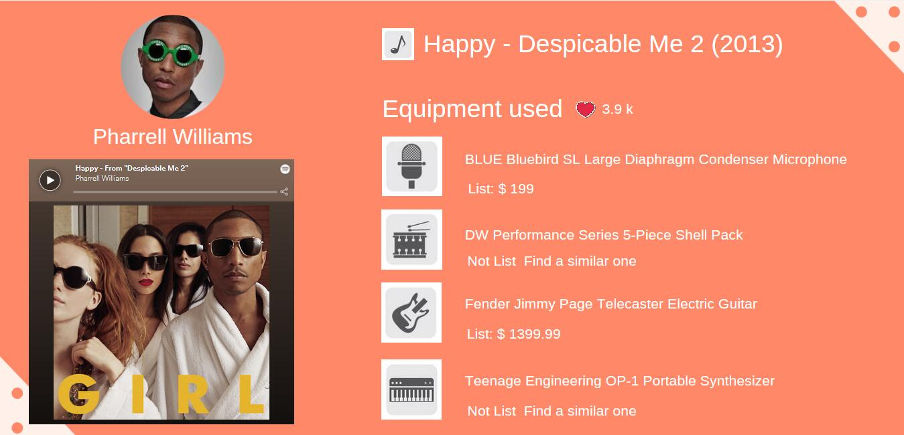
UI -- Musician Demo Song With Instrument info Page
Notes:
jin

Slide 5
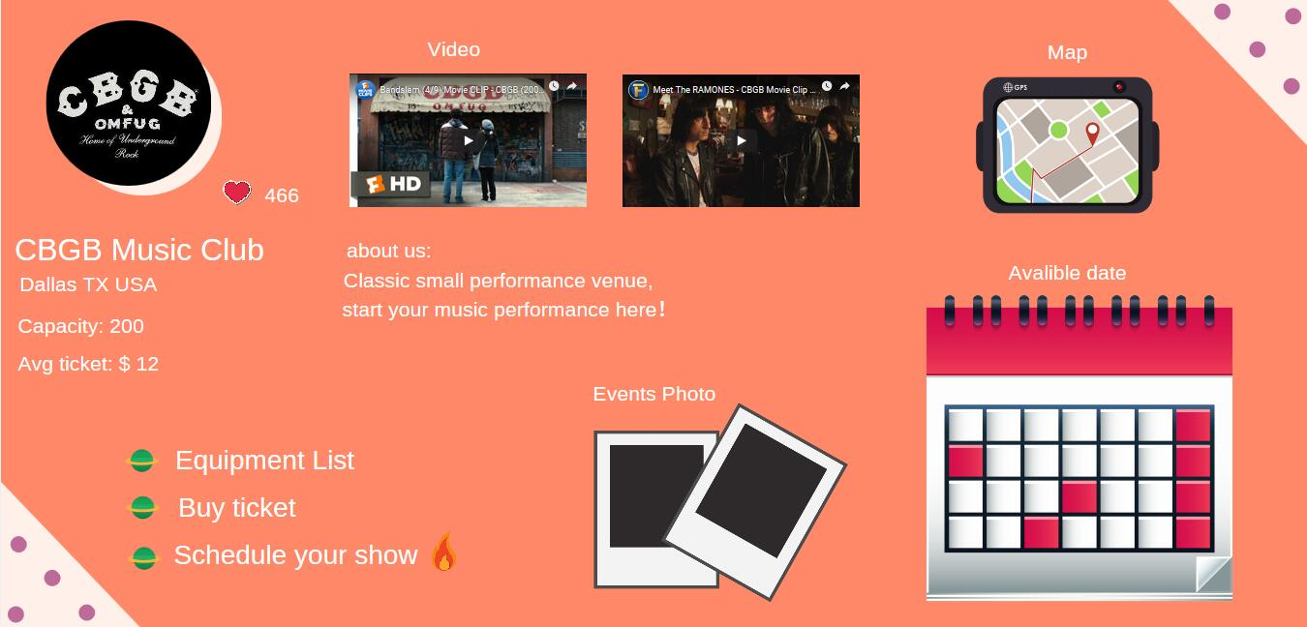
UI -- Business Main Page
Notes:
jin

Slide 6
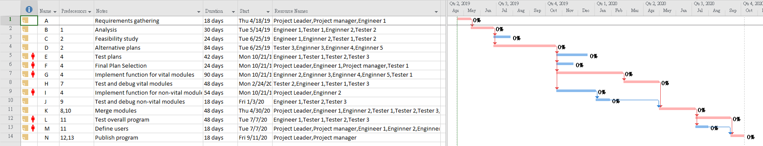
Project Timeline and Scheduling
Notes:
yang

Slide 7
Functional Requirements (1 of 2)
Users must be able to direct message with other users.
User may post comments to sellers product pages.
Seller may upload product pictures and descriptions.
Notes:
yang

Slide 8
Functional Requirements (2 of 2)
Software will give the seller the option to select music genre they belong to.
Seller may upload a music demo of 10 second for users to listen to.
Buyers can make an offer to the seller.
The website will schedule/track/update shipping information.
Notes:
yang

Slide 9
Non-Functional Requirements (1 of 4)
Performance Requirements:
Uploading speed of at least 1Mbps
Space requirements:
Website will have a backup of user accounts and transactions.
Accounting requirements:
Website will not retain/store user financial account information e.g. credit card numbers and bank information.
Notes:
Sanchez

Slide 10
Non-Functional Requirements (2 of 4)
Safety/security requirements:
User account passwords will be required to be 8 to 23 alphanumeric characters, as well as have one upper case, lower case, and symbol.
Usability requirements:
When an offer is accepted by a seller the buyer must fulfill payment for the product within 3 business days of offer acceptance.
Environmental requirements:
We will only provide paperless billing statements as our green initiative.
Notes:
Sanchez

Slide 11
Non-Functional Requirements (3 of 4)
Operational requirements:
Each user must have an account to make transactions. Users without an account will be able to view a demonstration of provided services.
Development requirements:
Service prototype will be completed in two months.
Legislative requirements:
Content will be in compliant with all Recording Industry Association of America standards, including parental advisory warnings for explicit lyrics.
Notes:
Sanchez

Slide 12
Non-Functional Requirements (4 of 4)
Ethical requirements:
Users can not post fake deals or imitation products, for high value products sellers must provide certificate of authentication.
Regulatory requirements:
Services will be provided over Transmission Control Protocol (TCP) as well as HTTPS
Efficiency requirements:
Service will ensure reliable data transfer (RDT) via TCP
Notes:
Sanchez

Slide 13
Cost Estimation
-Post-architecture technique to calculate the estimated cost for our project
-Overal calculation: 10 developers, 20 months
-Hardware cost: Server Pc, Laptops, printers, telephone, and others ( 25000$)
-Software cost: database service, Window server client licenses ( 5000$)
-Personnel cost : employment taxes, benefits, training, basic salary
Notes:
Doung

Slide 14
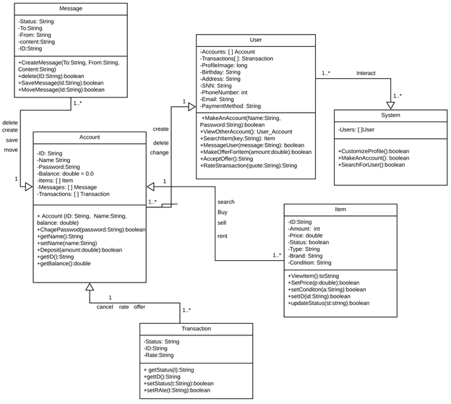
Class diagram
Notes:
Doung

Slide 15
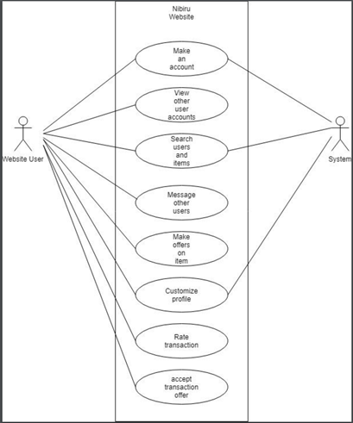
Use Case Diagram
Notes:
nhat

Slide 16
Architectural design
The goal of our project is to join the interaction between the buyer and the seller
The buyer and the seller have to communicate over a computer network
The buyer will send a request, and the seller will return a response
We decided to use client-server architecture for our project in order for every buyer to figure out how to use our software in a short time
Notes:
nhat

Slide 17
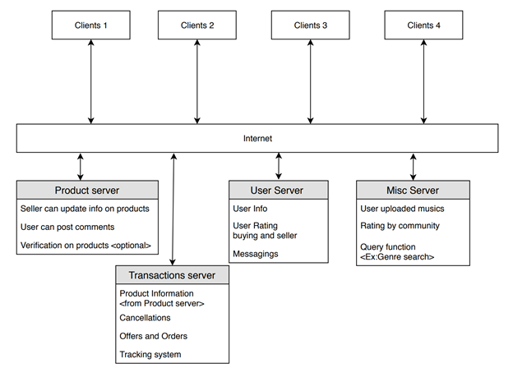
Client-server Architechture
Notes:
nhat

Slide 18
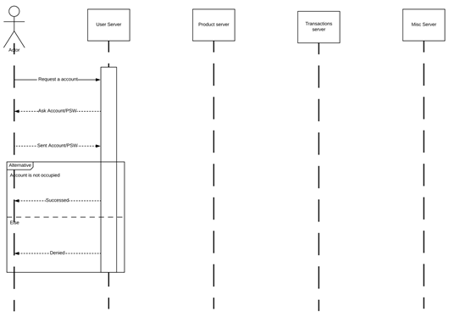
Sequence diagram:
Creating an Account
Notes:
Plinski

Slide 19
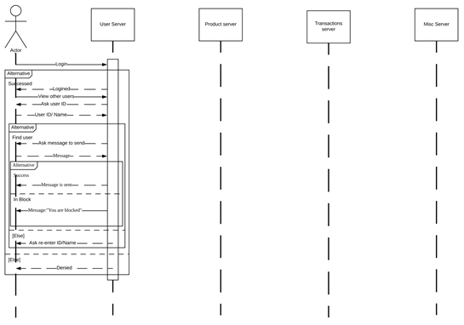
Sequence diagram: Message Other User
Notes:
Plinski

Slide 20
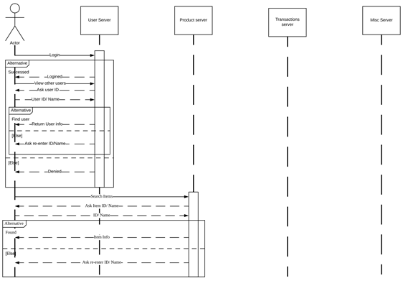
Sequence diagram: Search Other Accounts for Items
Notes:
Plinski

Slide 21
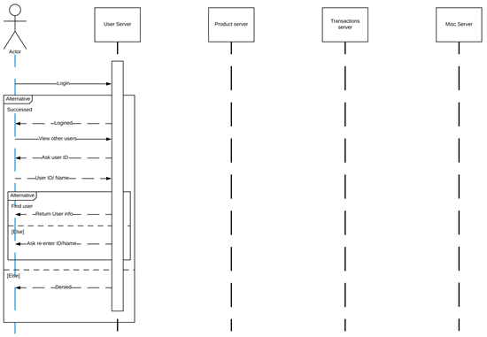
Sequence diagram: View Other Users
Notes:
Plinski

Slide 22
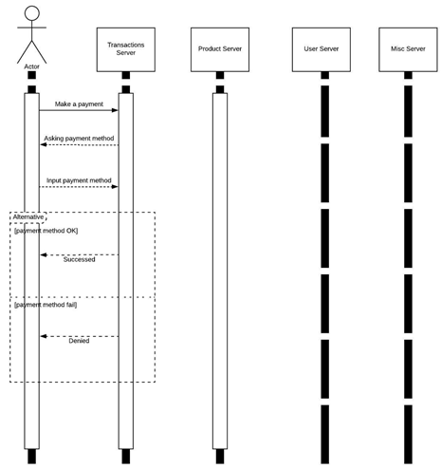
Sequence diagram: Accept Transaction Offer
Notes:
Plinski

Slide 23
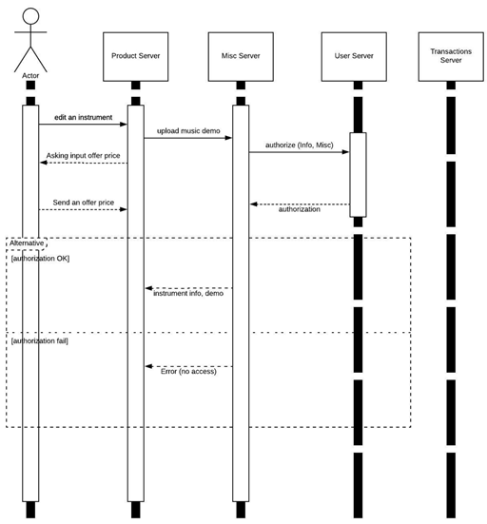
Sequence diagram: Customize Profile
Notes:
Plinski

Slide 24
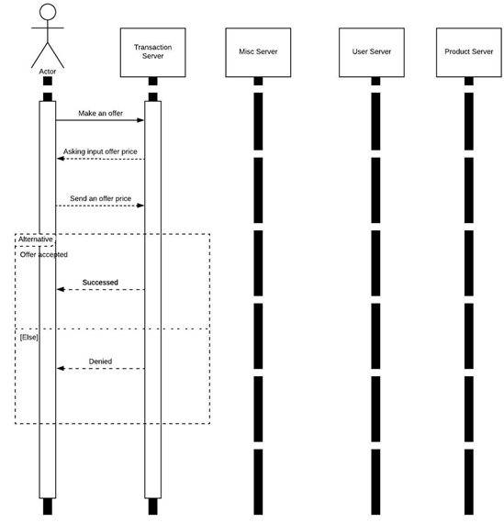
Sequence diagram: Make an Offer On an Item
Notes:
Plinski

Slide 25
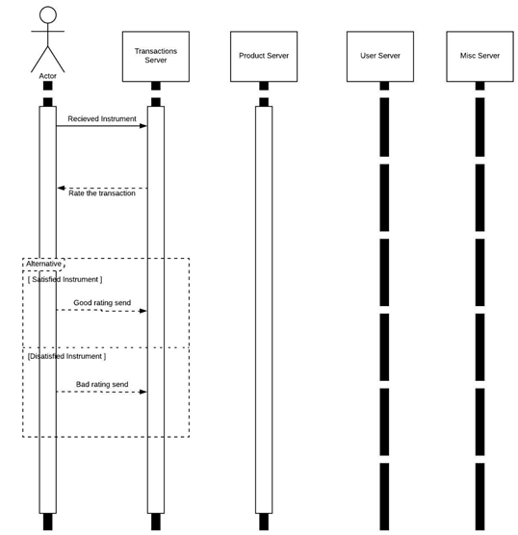
Sequence diagram: Rate a Transaction
Notes:
Plinski

Slide 26
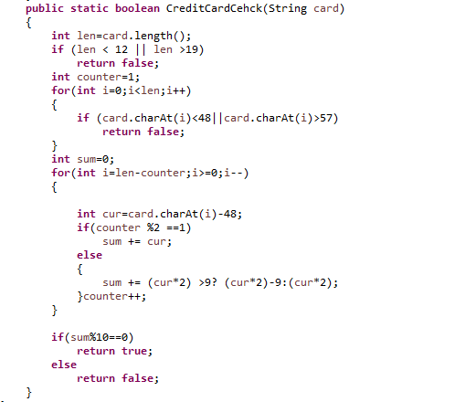
Code (1/2)
Code to examine the validation of credit card number

Slide 27
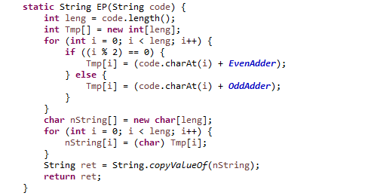
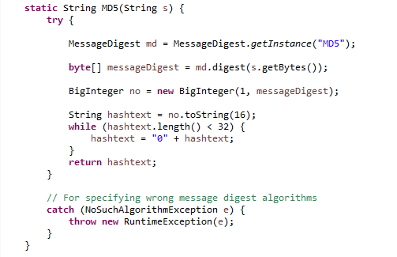
Code (2/2)
Code to encrypt data and to get the MD5 value

Slide 28
Conclusion
Nibiru is a web platform catering to musicians and their interactions with each other.
The design of the platform prioritizes user to user and user to server interactions.
To properly accommodate these interactions, the client-server architecture would be most appropriate.
Requirements are determined so that users have an efficient and safe experience.

